Slide 1
College Event Feedback Analysis
Using Google Form Data & Sentiment Analysis
Prepared by: Manya Gupta

Slide 2
Project Objective
To analyze student feedback for college events using Google Forms data, identify areas of improvement, and visualize insights through charts and sentiment analysis.

Slide 3
Data Collection
Feedback collected via Google Forms
Number of responses: 50–60 responses
Questions included:
Department, Year, Event Type
Overall Rating
Likes & Improvements
Recommendation

Slide 4
Tools & Libraries
Google Forms – Data collection
Google Colab – Data analysis
Python Libraries:
pandas – Data cleaning & analysis
seaborn / matplotlib – Visualization
textblob / VADER – Sentiment analysis
wordcloud – Highlight common words

Slide 5
Data Cleaning & Preparation
Handled missing values
Standardized Event Type and Department names
Converted text data for sentiment analysis

Slide 6
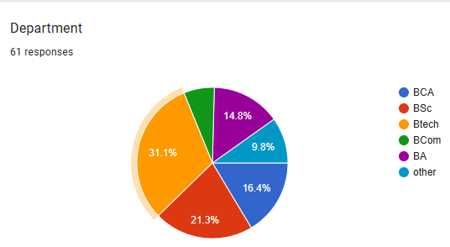
Overall Response Distribution
Distribution by Department

Slide 7
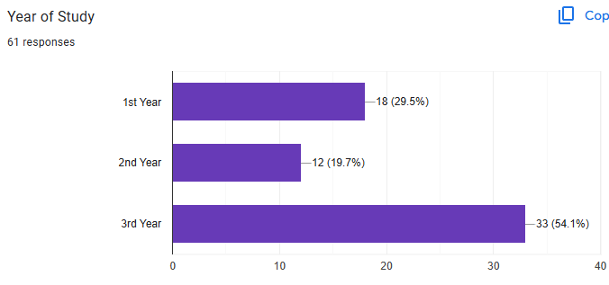
Distribution by Department

Slide 8
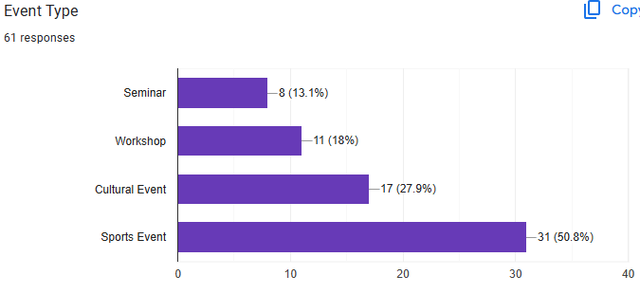
Distribution by Event type

Slide 9
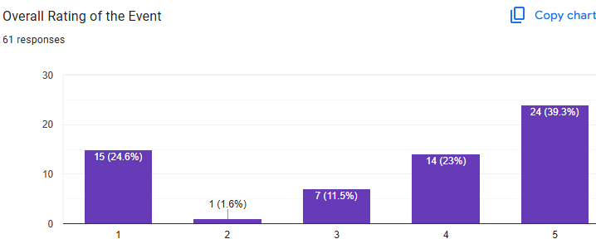
Overall Rating of the Event

